Slide 1
Claims Report
2016-2020

Slide 2
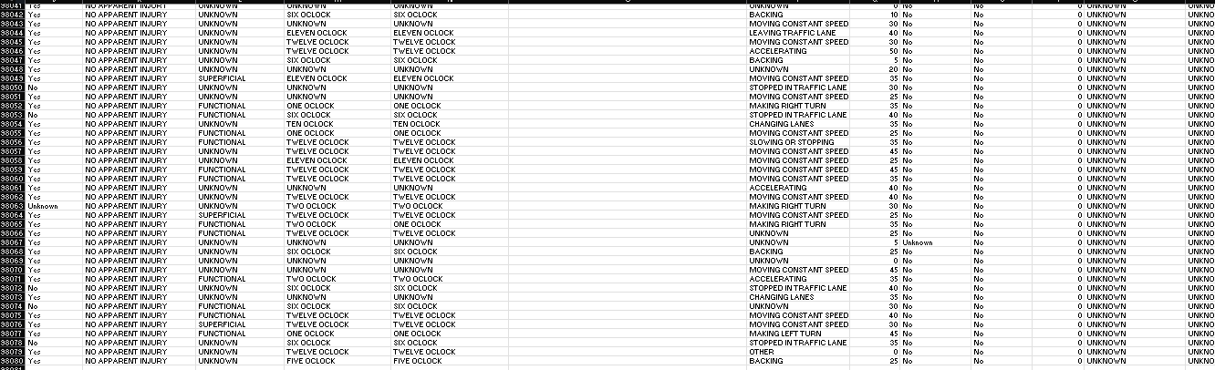
First Glance
Notes:
-Talk about the amount of data received
Also talk about thinking process to decide which column to decide as dependent and independent
First step was to check for duplicates left 98073 rows of data
Second was to fill in any blank cells/spaces = missing data?

Slide 3
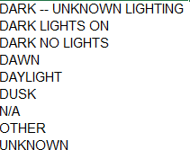

Deciding Factors
Multiple variations in each column would decide dependent/independent variable.
Dependent:
Crash time, crash month, crash year
Lighting
Weather
Non–motorist involvement
Road surface conditions
Driver substance abuse
Route
Notes:
(Animate pictures-words)

Slide 4
Visualizing the data
Based on the data, peak accidents are between 7am & 9am then again from 3pm to 6pm.
Could be considered “rush hour”
Notes:
-Since data includes cars and accidents, figured that “rush hour” may play a part in potential claims

Slide 5
Visualizing the data
Considering that “time” was a factor of the frequency of crashes, thought “in school” months may be a factor as well.
2020 was the lowest and highest was 2016
Notes:
- Since data includes cars and accidents, figured that “rush hour” may play a part in potential claims
Also wondered if the month/summer holidays was a factor (highlight summer month vs back to school months.
Wanted to see if the year was a factor too (what happened in 2020/2016?)
Seeing values together (month yr tab in excel)

Slide 6
Since the raw data shows that there are multiple dependent variables, needed to visualize how they affect the independent variables.
Weather
Please note that the hyperlinked Excel document is interactive.
Notes:
Wanted to see month/yr/qtr in real time
Jump to excel sheet and do filters
- Can have multiple dependent variables, which can vary.
Independent variables do not change or in this instance, have a limited variance= ie, route, year

Slide 7
Key findings
Factors that can impact the frequency of crashes include:
Time of day
Month of the year
Lighting
Weather
Surface(road) conditions
Driver abusing substances
The Maryland (State) route has a history of having more crashes.
Service roads have the least number of crashes.
Most crashes happen from 7am – 9am and then again from 3pm - 6pm.
The highest number of crashes were in 2016, what happened that may contribute?
The lowest number of crashes was in 2020, what happened in that year that may have contributed?
Crashes are more likely to happen towards the end of Q3 (September) leading into Q4 (October- December).
Toyotas tend to sustain more damage
There are an average of 4086 crashes per hour.
There are an average of 21100 crashes per year.
Most crashes happen during daylight.
All factors are not mutually exclusive to causing the number of crashes.
Notes:
Wanted to see month/yr/qtr in real time
Jump to excel sheet and do filters

